Slide 1
Week 7: Final Presentation

Slide 2
Motivation
The problem
Harmful cyanobacteria blooms can make drinking water and local water bodies unsafe
Monitoring means looking at water samples under a microscope by hand
That is slow, and it depends on a trained person
The City of Worcester, WCMC (Worcester Cyanobacteria Monitoring Collaborative) and Prof. Nathan Ahlgren study these samples
Notes:
Our project starts with a real problem. Cyanobacteria are tiny organisms in lakes and ponds, and when they grow out of control they form harmful blooms that can make water unsafe. The way people check for them is mostly by looking at samples under a microscope, one at a time. That takes a lot of time and a lot of expertise. Worcester’s water is monitored by the city and by WCMC, and our advisor Professor Ahlgren studies the samples, so this is data from our own community

Slide 3
The FlowCam
A FlowCam is a microscope camera that photographs particles in flowing water
It takes thousands of pictures per sample
Faster than a person, and the images can be re-checked later
Machine learning could help identify what is in each picture
Notes:
To speed this up, the lab uses a FlowCam. Water flows past a camera, and it takes thousands of pictures of the particles in it. That’s much faster than a person, and the pictures are saved so anyone can look again later. The goal is to train a machine learning model that can recognize cyanobacteria in those pictures automatically. But a model needs organized, labeled images, and that’s where the problem is.

Slide 4




















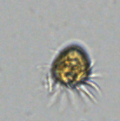








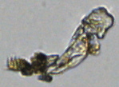




What we started with
About 550,000 images in 648 folders
No consistent folder naming
Could not search by site, date or magnification
Nothing labeled, so nothing a model could learn from
Notes:
When we got the data, it was about 550,000 images in 648 folders, and the folders were named in lots of different ways. You couldn’t search for a site or a date, you couldn’t compare samples, and none of the images were labeled. So the camera did its job, but the data wasn’t usable yet. That is the gap we worked on

Slide 5

Our Plan
Goal: turn raw FlowCam folders into a clean, searchable, labelable dataset
Step 1: organize it with a Python script
Step 2: put it in a database and dashboard
Step 3: build a tool for people to label images
Notes:
So our job was to build the foundation. We organize the data with a script, put it in a database with a dashboard anyone can use, and then build a tool so people can label images. Once that’s done, the machine learning work can begin

Slide 6
Methodology: Learning the data
Met with Prof. Ahlgren to learn how the data is made
-pp means post-processed, the city’s standard
TR/TM = trigger mode and AI = autoimage mode
Dilution is in the name, and magnification is 10x unless noted
Also learned from a paper on a FlowCam image pipeline
Notes:
Before writing code, we had to understand the data. We met with Professor Ahlgren, who explained the folder names. For example, ‘pp’ means post-processed, which is the city’s standard version. The codes in the name tell you the capture mode, the dilution, and the magnification. We also read a paper on FlowCam pipelines, which showed the same steps we ended up following: clean the data, then label it, then train a model.

Slide 7
Step 1: Python Script
Reads each folder name and extracts site, date, magnification, dilution and capture mode
Cleans up site names
Uses the -pp folder when both versions exist
Checks that every image opens (Pillow)
Output: one spreadsheet row per image (folder_name site_raw site_normalized, water_body_type, date, magnification, sample_code, capture_mode, dilution, is_pp, image_count, unreadable_count)
Notes:
The first step is a Python script. It goes through every folder, reads the name, and pulls out the site, date, magnification, dilution and capture mode. It fixes inconsistent site names, and if there’s a raw folder and a post-processed one for the same sample, it uses the post-processed one. It also checks that every image actually opens. The output is a spreadsheet with one row for every image.

Slide 8
Step 1: Script Results
511,765 images
613 folders, 45 sites, 36 sampling dates
0 unreadable files
31,605 duplicate images removed by using -pp folders
Notes:
Here are the results of the script. The final catalog has 511,765 images from 613 folders, 45 sites and 36 sampling dates, and none of the images were unreadable. We also found that 31,605 images were exact duplicates sitting in both the raw and the post-processed folders, and switching to the post-processed ones removed them.

Slide 9





Step 2: Choosing a database
Notes:
We had a meeting with Professor Catalin, Professor Potter, and Professor Han about databases. From that we came up with a $7 a month plan and a free plan, which after meeting with Professor Ahlgren; why not free. The biggest challenge is to run it for $0 your server needs to be static for this type of project, each service fills a gap a static website can’t fill itself
Supabase covers the data, accounts and permissions:
A real Postgres database. Logins built in. Google sign-in, email and password, confirmation emails and password resets all come ready-made. Row-Level Security. Rules like “anyone can read, only labelers can save labels” live in the database, so the security holds even though the website code is public.
Cloudflare covers the website and the images:
Pages hosts the website and redeploys it automatically on every GitHub push.
R2 holds the 3.65 GB of images.
The Worker serves them quickly from Cloudflare’s global network.
Why not the obvious alternatives?
Images in Supabase Storage: its free tier is only 1 GB
Images in GitHub: 3.65 GB is far too large for a repository.
AWS only allows free for around 6-12 months then it ends and charges money for downloads
For render: Free database expires after about 30 days unless you upgrade

Slide 10
Why Cloudflare & Supabase work so well
What | Free limit | Our usage
Postgres database (Supabase) | 500 MB | ~168 MB
Image storage (Cloudflare R2) | 10 GB | ~3.65 GB (511,765 images)
Image downloads from R2 | free, with no bandwidth charge | —
Image server (Cloudflare Worker) | 100,000 requests per day | No more than 10,000 a day
Website hosting (Cloudflare Pages) | no traffic charge | —
Notes:
If the storage needs to increase for postgres or image storage switch to Supabase for $25 a month
If more requests is needed, $5 a month -> 10 Million Requests per Day

Slide 11
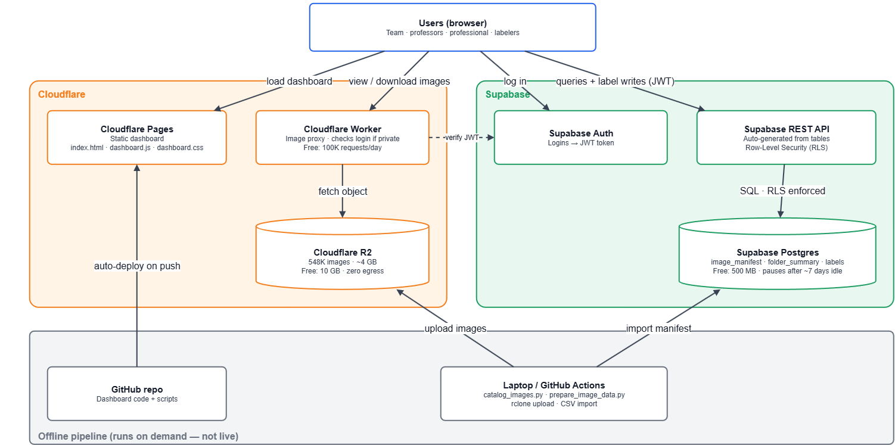
Notes:
[Whole diagram]
This is how our Water Sample Image Catalog runs online. There are three parts. On the left is Cloudflare, which serves the website and the images. On the right is Supabase, which holds our data and handles accounts. At the bottom is our offline pipeline, which is how new images get into the system. Everything here runs on free tiers, so hosting costs us nothing.
[Users box at the top]
It starts with a user in a web browser: our team, professors, or a labeler. They can do four things: load the dashboard, view or download images, log in, and, if they’re allowed, save labels on images.
[Cloudflare Pages]
“When someone opens the site, the dashboard comes from Cloudflare Pages. The dashboard is a static site: plain HTML, CSS and JavaScript files, with no server code running behind it. That’s why it’s fast and free to host. Pages is connected to our GitHub repo, so whenever we push changes, it rebuilds and redeploys the site automatically.” [trace the ‘auto-deploy on push’ arrow]
[Cloudflare Worker, then R2]
“The images themselves live in Cloudflare R2, which is cloud file storage. That’s over half a million microscope images, about four gigabytes. R2 has no download fees, which matters because people browse a lot of images. The browser never talks to R2 directly. It goes through the Cloudflare Worker, a small program that acts as our image server. You ask it for an image, it fetches that file from R2 and hands it back, or sends it as a download. It can only hand images out; nobody can change or delete them through it.”
[Supabase Auth]
“Now the Supabase side. When someone logs in, with Google or with an email and password, Supabase Auth checks who they are and gives the browser a token called a JWT. Think of it as a signed ID badge. The browser shows that badge with every request after that.”
[Supabase REST API, then Postgres]
“All of our data, every folder, site, date, image count and label, lives in a PostgreSQL database. The browser doesn’t connect to the database directly. It goes through Supabase’s REST API, which Supabase generates automatically from our tables. The important part is Row-Level Security. The rules about who can do what live inside the database itself. Anyone can read the catalog. Only labelers and admins can save a label, and even then they can only change the label column, nothing else. Only admins can change people’s roles. So even if someone tampered with the website code in their browser, the database would still refuse anything they aren’t allowed to do.”
[Offline pipeline at the bottom]
“Finally, the bottom box is how data gets in, and it only runs when we add new samples. First, our Python script, catalog_images.py, scans the raw image folders and builds a catalog: one row per image and a summary per folder. Then we import that catalog into the Postgres database. Then we upload the image files to R2 with a tool called rclone. Once that’s done, the new samples show up on the live dashboard automatically.”
[Wrap-up]
“To sum up: Cloudflare serves the website and the images. Supabase stores the data, handles logins and enforces permissions. The pipeline on our laptop feeds new images into both. Each piece does one job, it all fits in free tiers, and the security is enforced by the database, not by the web page.”

Slide 12
Step 3: The Dashboard
Anyone can browse, filter and download images
Filters: site, date, water body, magnification
Charts and a detail view for each folder
Light and dark mode, works on phones
Admin page that allows authorized users to change users access level
Available at: https://water-sample-dashboard.pages.dev/
Notes:
The dashboard is the front door. Anyone can open it without an account, filter by site, date and water body, see charts, and click a folder to see its images and download them. We also made it work on phones and added a dark mode

Slide 13
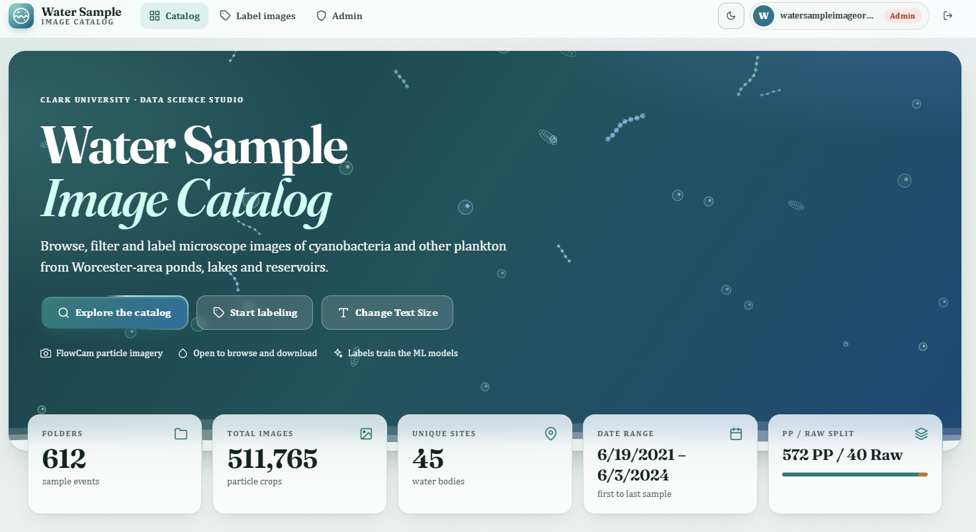
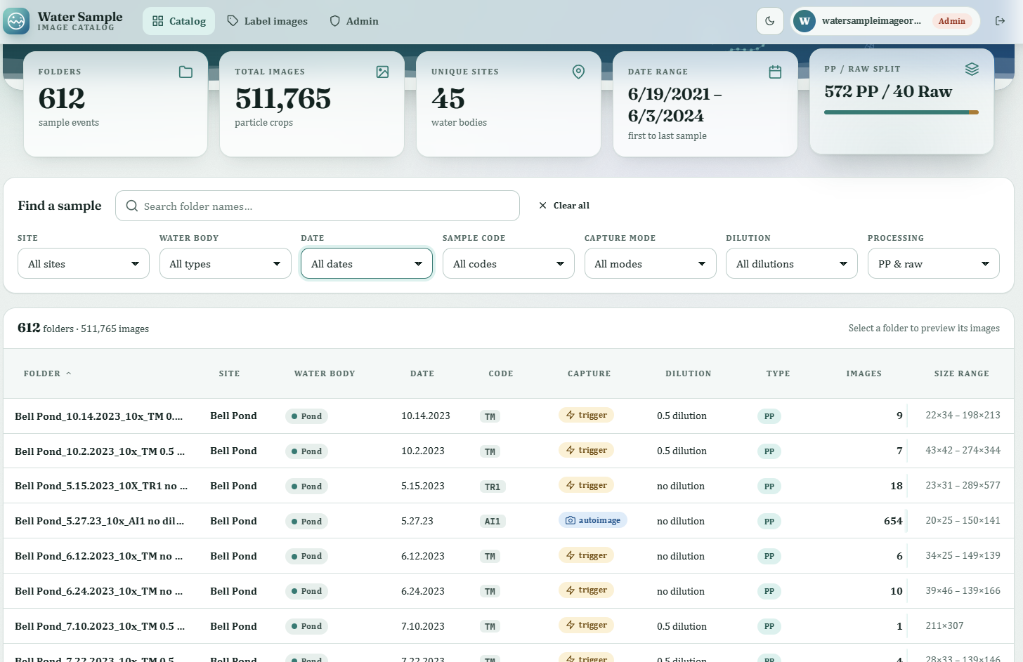
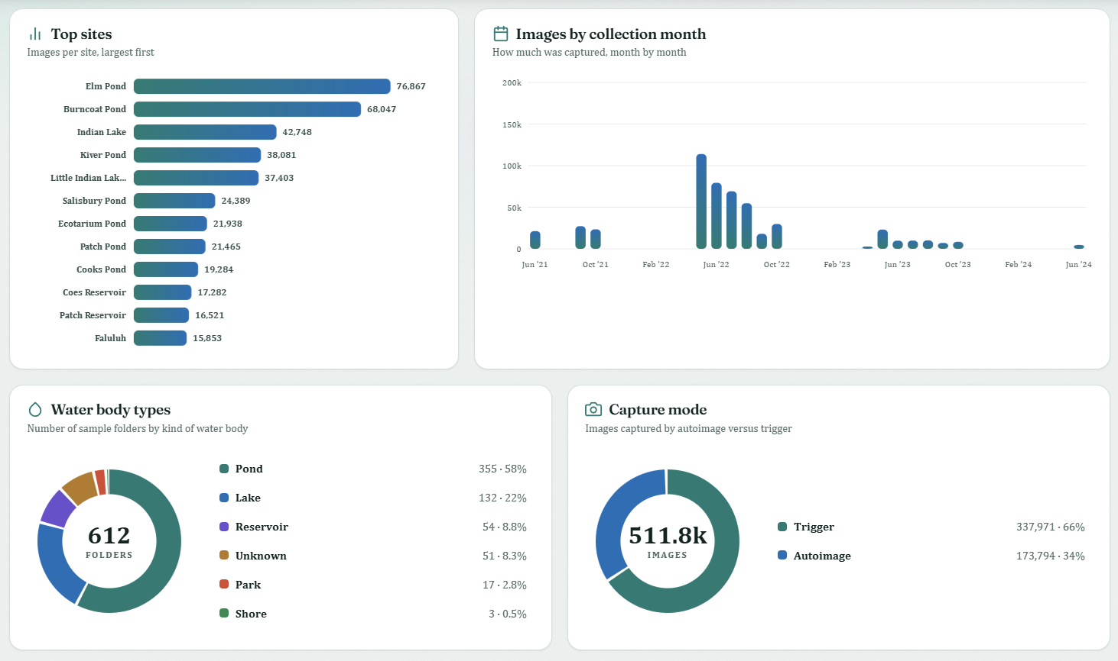
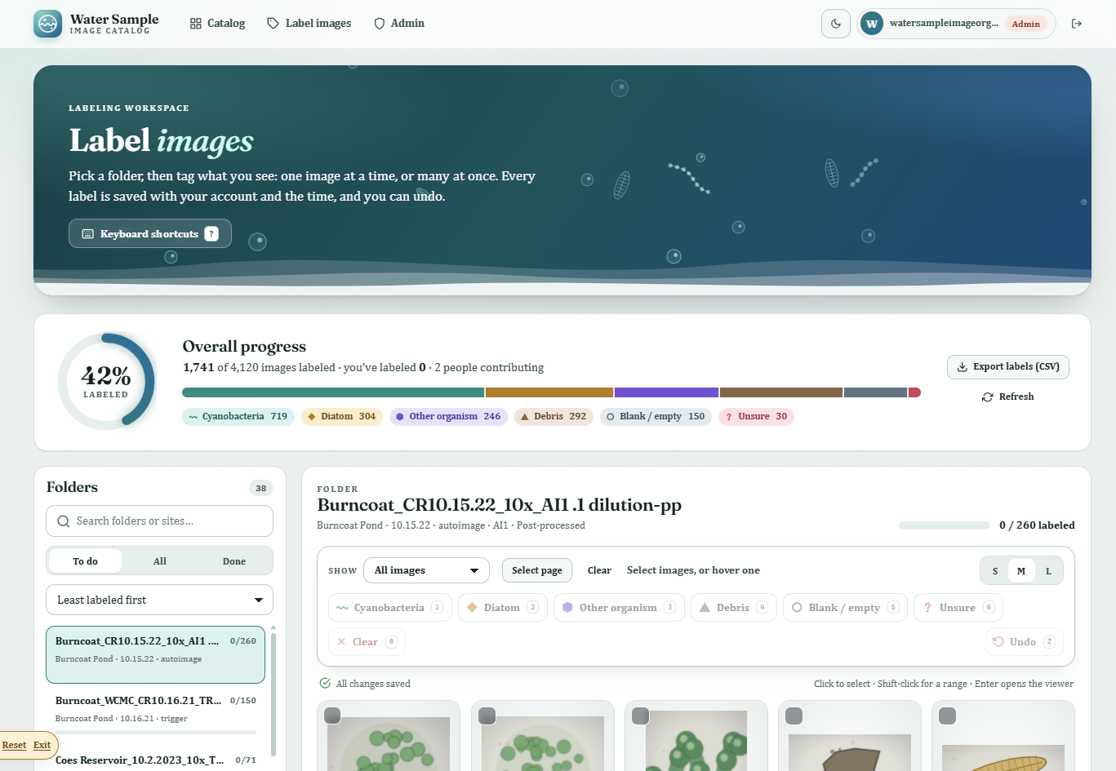
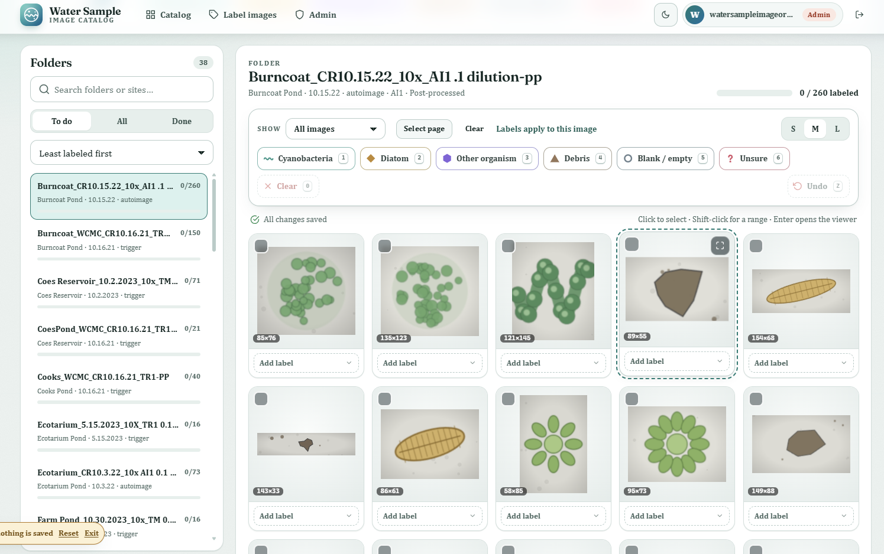
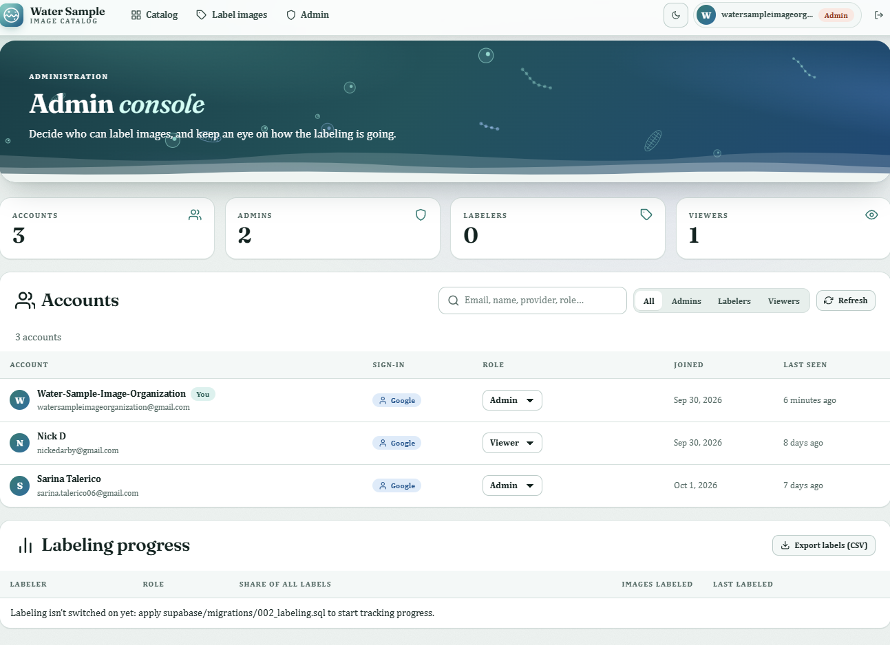

Slide 14
Step 4: Labeling
Select many images at once, or press number keys to label
Image viewer, undo, and progress tracking
Records who labeled each image and when
Export labels to CSV
Only approved users can label
Notes:
The last piece is the labeling tool, and this is where machine learning gets its training data. A labeler can select a whole group of images and press a number key to label them, open an image to look closely, and undo mistakes. It shows how much of the dataset is done, and the database records who labeled each image and when. Only approved users can label, and the labels export as a CSV for the model

Slide 15
Limitations
648 folders, no consistent naming
43 raw folders that didn’t match the rest
37 folders missing magnification
-pp wasn’t a clean filter, and some -pp folders duplicated their raw versions
Site names didn’t match: Patch Pond vs. Patch Reservoir, Chauncey vs. Chauncy
Notes:
We hit a lot of problems early on. The naming was inconsistent across 648 folders. Thirty-seven folders had no magnification. We didn’t know what ‘pp’ meant at first, and even after we did, it wasn’t a clean filter, because some post-processed folders repeated images from their raw version. We also couldn’t tell if names like Patch Pond and Patch Reservoir were one site or two. Most of these we fixed with the script and by asking Professor Ahlgren, but a few site names are still not merged.

Slide 16
Discussion
WCMC
Clark University Biology Department
Over 500 Thousand PNG files
?
Clark University Biology Department
WCMC
Notes:
So far the Worcester Cyanobacteria Monitoring Collaborative collects samples from around mass, sends them to Clark Uni where Bio department analyzes them with a flowcam using the proprietary visualspreadsheet6 software which in turn generated hundreds of thousands of images which didn’t have a place to be stored/analyzed

Slide 17

Future work
Determine label categories
Labelling system
Merge Chloe’s work
Perfect the admin page
Produce an ML classifier
Meet with users

Slide 18
Final Thoughts: What we built
A Python script that organized 511,765 images from 613 folders, 45 sites and 36 sampling dates
A free database and website: Cloudflare for images and hosting, Supabase for data and logins
A dashboard anyone can use to browse, filter and download images
A labeling tool with bulk labeling, undo, progress tracking and who/when records
Accessible design
Notes:
Let’s look at what we actually built. We started with about half a million images in folders nobody could search, and we ended with one organized catalog of 511,765 images across 45 sites. On top of that there’s a free database and website, a dashboard where anyone can browse, filter and download images, and a labeling tool where approved people can tag images and the system remembers who labeled what and when. We also made it accessible, with dark mode and a demo mode so anyone can try it without an account. And all of it runs on free services.

Slide 19
Final Thoughts: What we learned
Data is messy, most of the work was understanding the data, not coding
Ask early: Prof. Ahlgren’s answers (like what -pp means) helped us from wrong assumptions
Check your assumptions: -pp wasn’t a great filter, and we found 31,605 duplicates
Plan for the future: choosing a free setup keeps the project alive after the semester
Teamwork: the script, database, dashboard and labeling tool each came from a different part of the team
Notes:
We learned a few big things along the way. First, real data is messy, and most of our time went into understanding it rather than writing code. Second, asking the expert early matters. When we assumed what ‘pp’ meant, we were partly wrong, and Professor Ahlgren’s answers fixed that. Third, check your assumptions. We found 31,605 duplicate images only because we looked closely. Fourth, we picked a free setup so the project can keep running after this class ends. And finally, this only worked because the team split it up: the script, the database, the dashboard and the labeling tool each had owners who kept checking in with each other.

Slide 20
Before Vs After
Before: finding and comparing samples meant digging through folders by hand
Now: the data is searchable, documented and shared
It makes machine learning possible, because models need organized, labeled images
Notes:
We learned a few big things along the way. First, real data is messy, and most of our time went into understanding it rather than writing code. Second, asking the expert early matters. When we assumed what ‘pp’ meant, we were partly wrong, and Professor Ahlgren’s answers fixed that. Third, check your assumptions. We found 31,605 duplicate images only because we looked closely. Fourth, we picked a free setup so the project can keep running after this class ends. And finally, this only worked because the team split it up: the script, the database, the dashboard and the labeling tool each had owners who kept checking in with each other.

Slide 21
Thank you, Prof. Han, Prof. Potter, Prof. Ahlgren, & Prof. Catalin.
Sarina and Nick

